Slide 1
Factors influencing time resolution in scintillators
Paul Lecoq
CERN, Geneva
Notes:
Considering the increased interest for fast coincidence timing resolution in new generation of PET’s, we are trying to systemacally insvestigate the factors, which limz this resolution

Slide 2
Where is the limit?
Philips and Siemens TOF PET achieve
550 to 650ps timing resolution
About 9cm localization along the LOR
Can we approach the limit of 100ps (1.5cm)?
Can scintillators satisfy this goal?
Notes:
Can we approach this limit in practical systems?

Slide 3
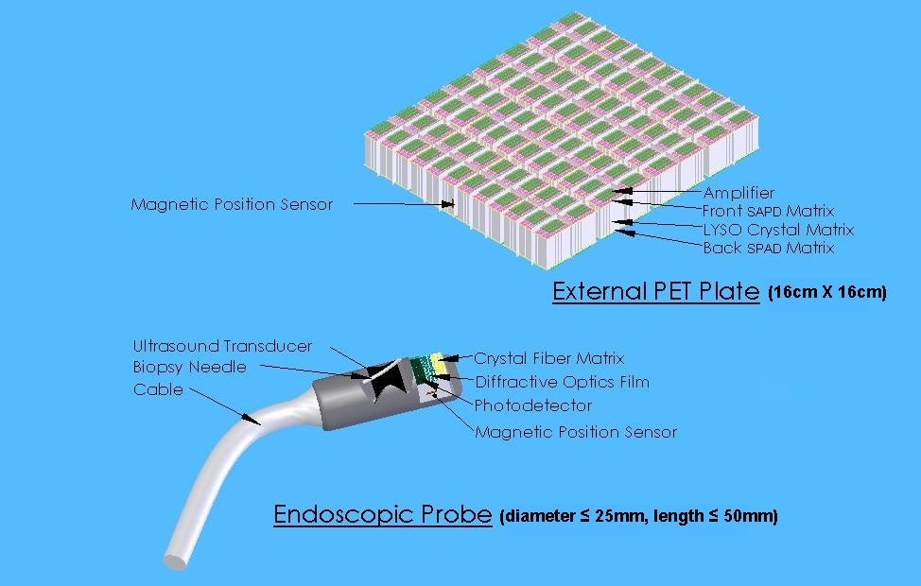
Development of new biomarkers
First clinical targets: pancreatic/prostatic cancer
Tool: dual modality PET-US endoscopic probe
Spatial resolution: 1mm
Timing resolution: 200ps
High sensitivity to detect 1mm tumor in a few mn
Energy resolution: discriminate Compton events

Slide 4
Timing parameters
General assumption , based on Hyman theory
decay time of
the fast component
Photodetector
excess noise factor
For the scintillator the important parameters are
Time structure of the pulse
Light yield
Light transport
affecting pulse shape, photon statistics and LY
number of photoelectrons generated by the fast component
Notes:
Dans la formule il intervient aussi les caractéristiques temporelles du photodétecteur
The light transport affects both time structure of the pulse and LY

Slide 5
Statistical limit on timing resolution
W(Q,t) is the time interval distribution between photoelectrons
= the probability density that the interval between event Q-1 and event Q is t
= time resolution when the signal is triggered on the Q^{th} photoelectron
N_{phe}
N_{phe}
N_{phe}
τ_{d} = 40 ns
τ_{d} = 40 ns
N_{phe}=2200
LSO
N_{phe}

Slide 6
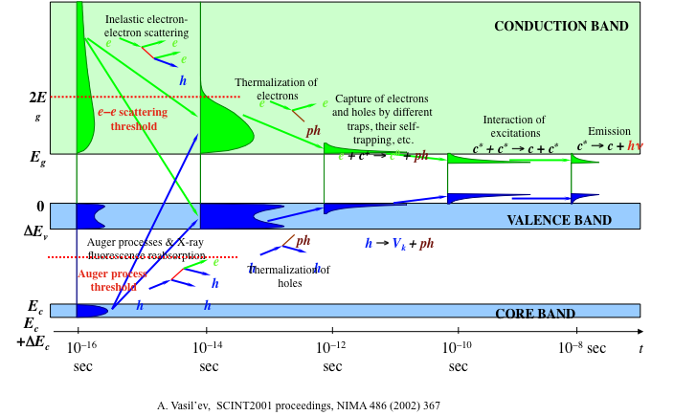
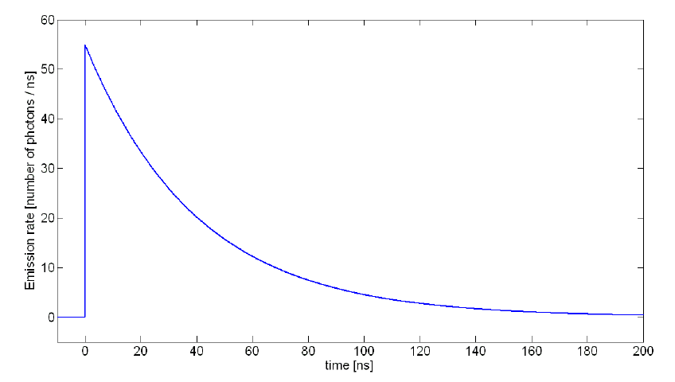
Light generation
5d
Rare Earth
4f
Notes:
But this is based on a very simplified view of he pulse shpe, which consists of considering only the last part of a very complex energy conversion process in the scintillator

Slide 7
Factors influencing the scintillation decay time
Three important aspects
Dipole and spin allowed transitions
Short wavelength of emission
High refractive index

Slide 8
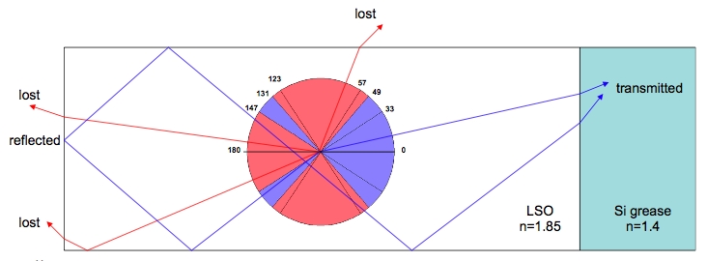
Light Transport
For a 2x2x20 mm³ LSO crystal
Maximum time spread related to
difference in travel path is
424 ps peak to peak
≈162 ps FWHM
-49° < θ < 49° Fast forward detection 17.2%
131° < θ < 229° Delayed back detection 17.2%
57° < θ < 123° Fast escape on the sides 54.5%
49° < θ < 57° and 123° < θ < 131°
infinite bouncing 11.1%
Notes:
To further improve we have to work on the light transport, and in particulr try to increase the number of direct photons transferred to the potodetector

Slide 9
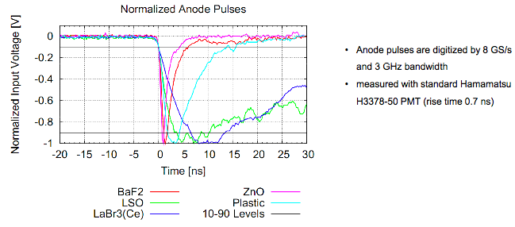
Rise time
Rise time is as important as decay time
W(Q,t) is the time interval distribution between photoelectrons
= the probability density that the interval between event Q-1 and event Q is t
= time resolution when the signal is triggered on the Q^{th} photoelectron

Slide 10
Time resolution with rise time
The intensity of light signal of a scintillating crystal can be described by the Shao Formula
The number of photo-electrons firing the photo-detector
N(t) between 0 and t after simplifications is given by :
Arrival time of first photon :
Coincidence time resolution CTR :

Slide 11
Photon counting approach
LYSO, 2200pe detected, τ_{d}=40ns
τ_{r}=0.5ns
τ_{r}=0ns
τ_{r}=1ns
τ_{r}=0.2ns

Slide 12
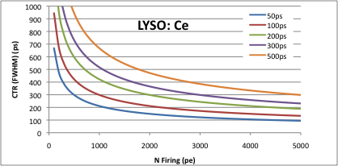
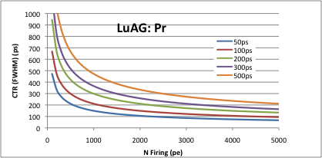
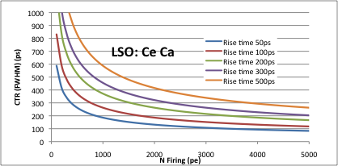
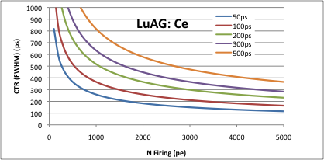
Variation of CTR for different crystals with different rise times

Slide 13
Crystal specifications for 200ps CTR
Impossible for LuAG:Ce

Slide 14
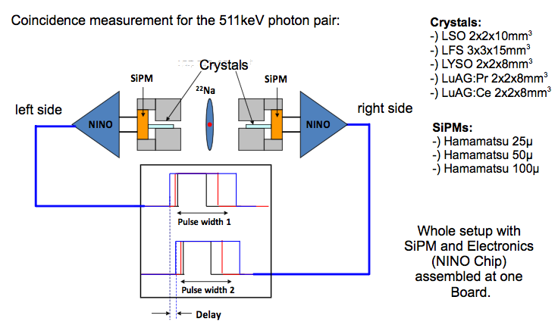
Coincidence SiPM-SiPM
Notes:
Set-up developped in the frame of another project

Slide 15
Summary of results
 | FWHM in coincidence Hama. 25μ | FWHM in coincidence Hama. 50μ | FWHM in coincidence Hama. 100μ
Fill Factor: | 30.8% | 61.5% | 78.5%
Number of Pixels: | 14400 | 3600 | 900
Best Settings: | 73V Bias 150mV Th. | 72.4V Bias 100mV Th. | 70.3V Bias 300mV Th.
LSO with LSO 2x2x10mm³: | 340±9ps | 220±4ps | 280±9ps
LFS 3x3x15mm³: | 429±10ps | 285±8ps | 340±3.2ps
LuAG:Pr with LuAG:Pr 2x2x8mm³: | 1061±40 ps | 672±30 ps | 826±40 ps
LuAG:Ce with LuAG:Ce 2x2x8mm³ : | 1534±50 ps | 872±50 ps | 1176±50ps
LYSO with LYSO 2x2x8mm³: |  |  | 282±9ps
LYSO with LYSO 0.75x0.75x10mm³: | 360±22ps | 208±20ps

Slide 16
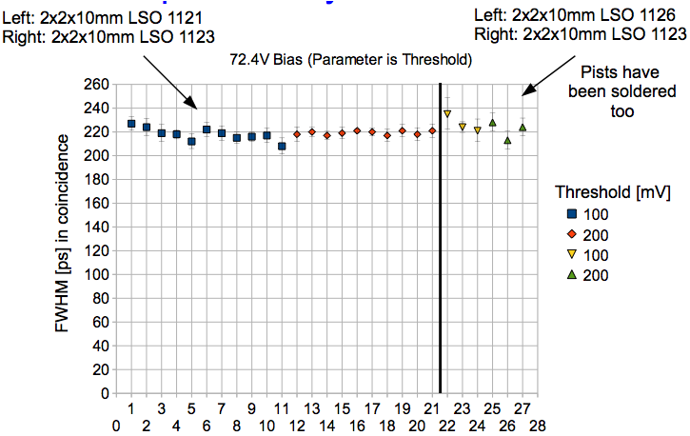
Reproducibility LSO vs LSO
SiPM Hamamatsu 50μm

Slide 17
Comparison between predictions & experimental results
Crystals | Nbre pe firing SiPM 25μm @511keV | CTR Measured SiPM 25μm | Predicted with Shao formula
LSO 2x2x10mm³ | 817 | 340ps | 330ps
LYSO 0.75x0.75x10mm³ | 786 | 360ps | 336ps
LuAG:Ce 2x2x8mm² | 300 | 1534ps | 1492 ps (decay 60ns) 1553ps (decay 65ns)
LuAG:Pr 2x2x8mm² | 125 | 1061ps | 842ps (rise time 200ps) 1031 ps (risetime 300ps)

Slide 18
Conclusions
Timing resolution improves with lower threshold
Ultimate resolution implies single photon counting
High light yield is mandatory
100’000ph/MeV achievable with scintillators
Short decay time
15-20ns is the limit for bright scintillators (LaBr₃)
1ns achievable but with poor LY
Crossluminescent materials
Severely quenched self-activated scintillators
SHORT RISE TIME
Difficult to break the barrier of 100ps

Slide 19
Our Team
CERN
Etiennette Auffray
Stefan Gundacker
Hartmut Hillemanns
Pierre Jarron
Arno Knapitsch
Paul Lecoq
Tom Meyer
Kristof Pauwels
François Powolny
Nanotechnology Institute, Lyon
Jean-Louis Leclercq
Xavier Letartre
Christian Seassal

Slide 20
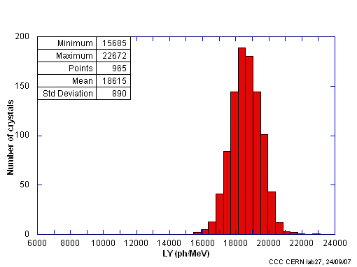
Light output: LYSO example
Statistics on about 1000 LYSO pixels 2x2x20mm³
produced by CPI
for the ClearPEM-Sonic project (CERIMED)
Mean value = 18615 ph/MeV
For 511 KeV and 25%QE: 2378 phe
Assuming ENF= 1.1
Nphe/ENF ≈ 2200 phe

